Slide 1




1/14
Coffee on Hold
Should You Delay Your Morning Coffee?
DATASCI 241 Section 1 Spring 2025
Anni Yao | Farhan Quadri | Mala Ramakrishnan | Brian Wesche
Paper | Survey

Slide 2






2/14
W241 Group (Optional slide if you want to post your picture here)
Anni Yao
Farhan Quadri
Mala Ramakrishnan
Brian Wesche

Slide 3




3/14
Presentation Overview
01
Introduction, Background, and Hypothesis
02
Experimental and Measurement Design
03
Pilot Study and Results
04
Project Analysis and Results
05
Conclusion

Slide 4

4/14
Introduction
Coffee Facts
Coffee is the most common source of caffeine in the U.S.
Over 85% of Americans report drinking at least one coffee or caffeinated beverage daily (Mitchell et al., 2014).
Prior observational research suggest that delaying your first cup may help avoid the mid-day energy “crash” (Benington & Heller, 1995; Rains, 2022).
Objective
Our study tests whether drinking coffee two hours after waking leads to better sustained alertness than drinking it right away after waking up.
Background
When individuals wake up in the morning from a night’s sleep, they have the lowest amount of a neurotransmitter called adenosine
Caffeine works by blocking adenosine receptors, reducing the feelings of fatigue and sleepiness that are associated with adenosine. This leads to enhanced alertness, reaction speed, and focus.
Delaying caffeine for a couple hours after waking may help to reduce tiredness.

Slide 5



5/14
The Coffee Study
Experimental Conditions:
Control: Consume caffeine within 20 minutes of waking.
Hypothesis:
Null Hypothesis (H₀): There is no significant difference in sustained energy levels (as measured by the Alert Index) between immediate and delayed caffeine intake groups.
Alternative Hypothesis (H₁): Delaying caffeine intake by two hours leads to significantly higher self-reported sustained energy levels.
2. Intervention: Delay caffeine intake by 2 hours after waking.

Slide 6




6/14
Experiment Design
Data Collection
The self-reported survey creates an “alert index”
This index score helps to quantify a participant’s energy levels and compare the control and treatment groups
Key Metrics (1-5 scale):
Alertness: “How do you feel right now?”
Cognitive Focus: “Are you able to focus on a task?”
Physical Energy: “Physically, how do you feel?”
We are considering changing this to a 7 point likert scale, or a 0-100% question to force more differentiation
Monitoring and Compliance:
Because this will be self-reported data, we would ensure accuracy and minimize bias using methods such as:
Use clear and standardized survey questions to ensure consistency in responses.
Send reminders to participants to complete the survey at the correct time (6 hours after coffee intake)
Verify responses with time-stamped data
Notes:
https://docs.google.com/presentation/d/13gWyihQDKnXlgEbJOicQxlXhewMECHJUAmWqtrDs5fc/edit?usp=sharing
https://docs.google.com/document/d/16F4-q14oeCUYA5-Bs-7RXZzLtZjPf5X_R7fqc6AMHD0/edit?usp=sharing

Slide 7
7/14
Measurement Design
Define Alert Index Score questions
We ask how they’re feeling currently; is that the outcome or do we want to consider asking them how they’ve felt throughout the day or week to make it more holistic?
We should consider collecting what time the respond to the alertness form?
Should we consider asking them an alertness index prior to treatment as well?
Define Alert Index Score calculation/weights
Are we weighting all questions equally?

Slide 8
8/14
Measurement Design - Farhan edited
Alert Index Survey
Participants took the survey 6 hours after waking up
Participants were evaluated on three criteria to assess their energy levels and alertness:
Awakeness
Difficulty of completing tasks
Physical fatigue
Each of these criteria were evaluated by participants on a scale of 1-5
Adding these scores together is the Alert Index Score which was used to compared the control and treatments groups
Participants had to record the time they woke up, drank coffee, and completed the survey to ensure transparency

Slide 9


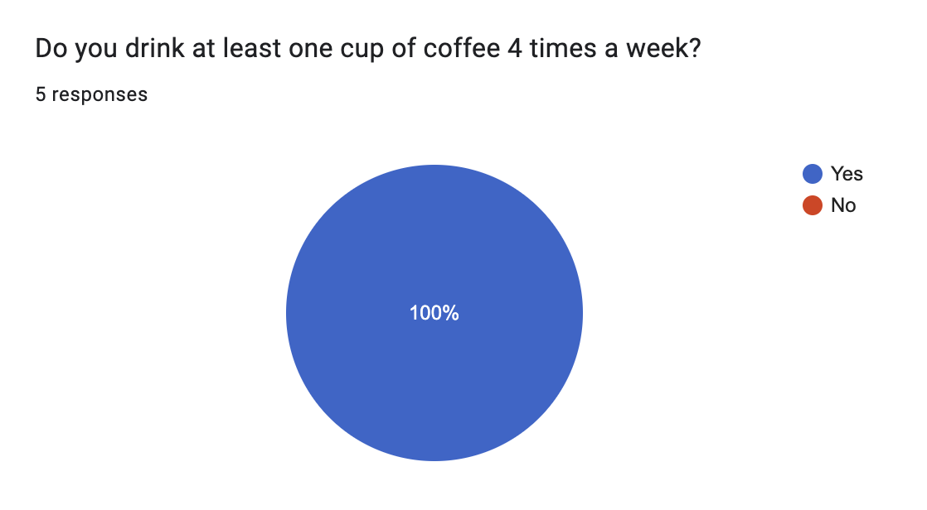
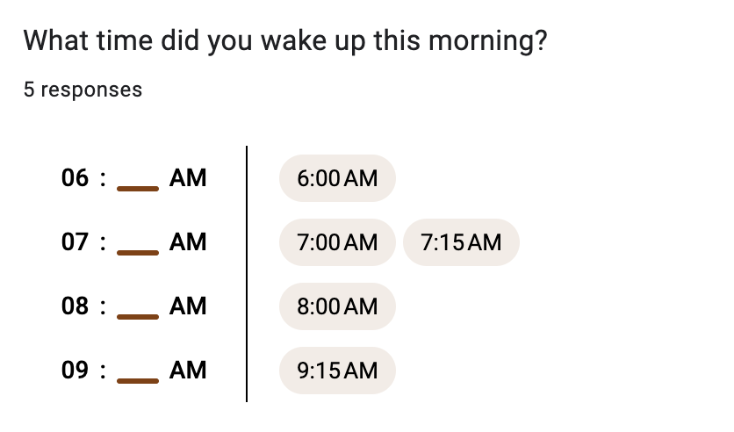
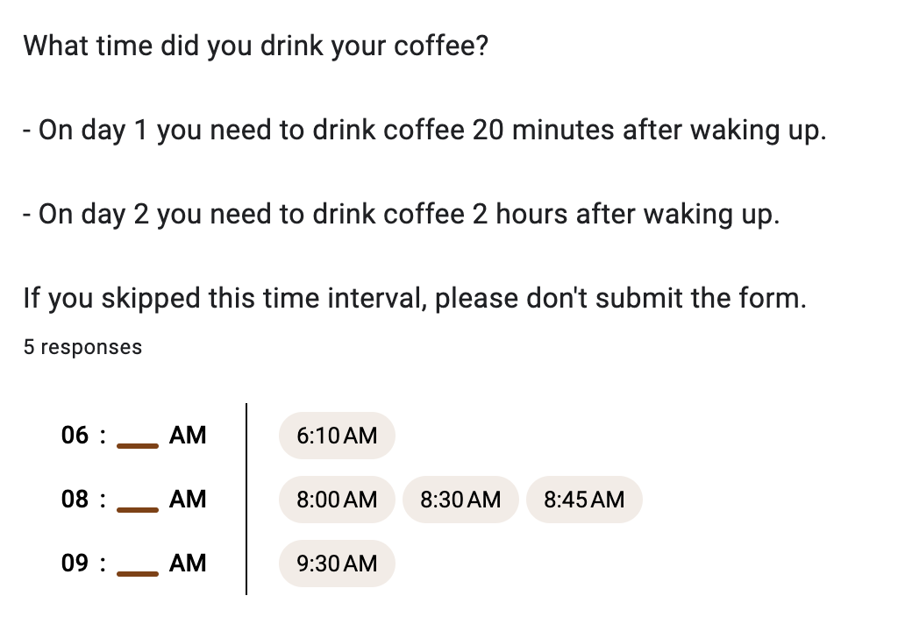
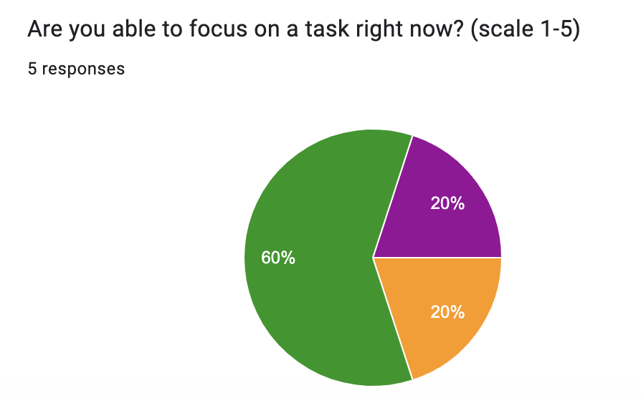
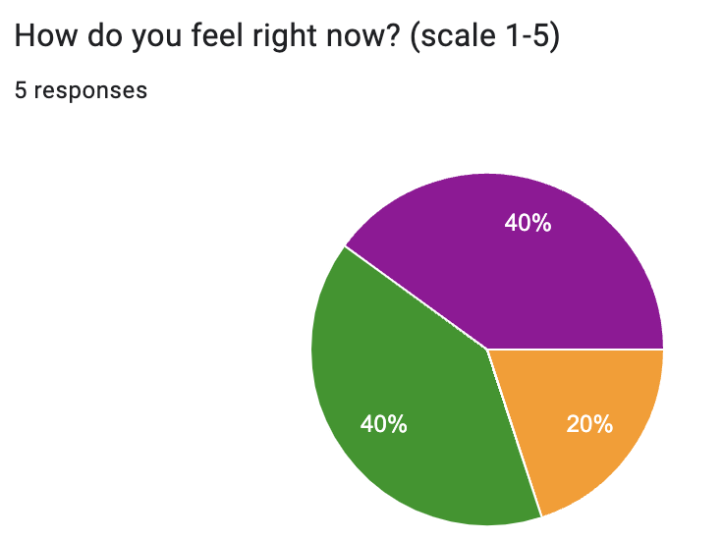
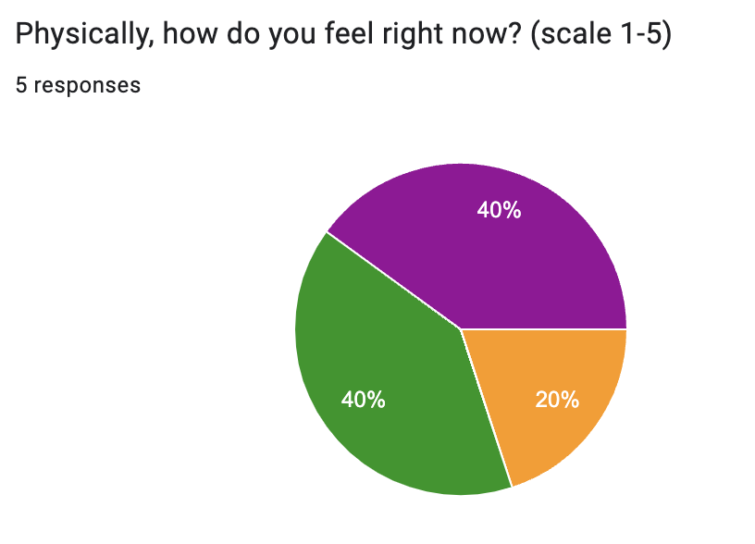
8/14
Pilot Study & Results
The pilot helped improve the survey to get more accurate results
It helped us rethink the study
3 respondents selected 4 and 5 - is that enough differentiation, or do we need to think about re-wording measures to say a 9 point scale?
2 hours represents a change for all of these people - will they be ok delaying caffeine intake if they’re used to drinking it an hour later?
Will respondents go back the second day to complete the survey?

Slide 10

9/14
Flow Diagram of Participants for in Network Cohort
“In Network” participants were defined as study participants that were enrolled from our group’s personal social/professional networks
44 individuals participated in the study
Selection criteria: individuals must drink a least 4 cups of coffee/week
Used time window to assign control and treatment groups (<=30 mins qualified to be in the control group, >60 mins and <= 3 hours qualified as treatment group)
Total participants
N = 44
Participants meet selection criteria
N = 41
Participants meet time window criteria
N = 36
Treatment group
N = 16
Control group
N = 20
Participants in both
N = 8

Slide 11
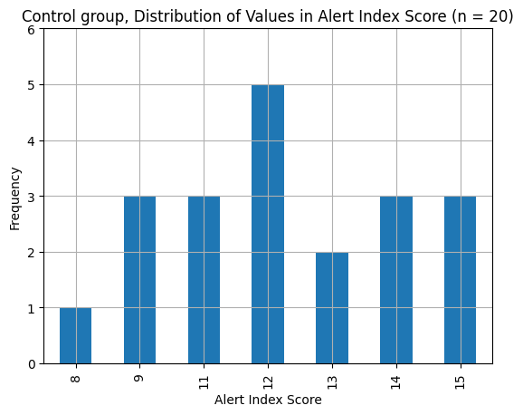
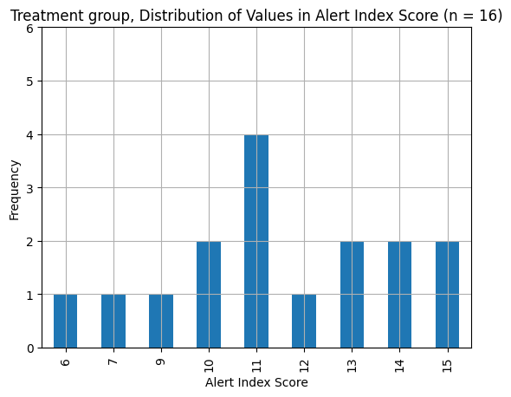
10/14
Project Analysis and Results - in Network Cohort
“In Network” participants were defined as study participants that were enrolled from our group’s personal social/professional networks
44 individuals participated in the study
Control n =20, treatment n = 16 (5 were disqualified). 8 were in both control and treatment
ATE for between-subjects comparison (n = 36): -0.7 (unpaired t-test, <0.05)
ATE for paired differences comparison (n = 8): -0.4 (paired sample t-test, <0.05)
We observed a small decrease in the alert index score when delaying coffee consumption by 2 hours after waking up, but this was not statistically significant
Cohen’s d was 0.28 (assuming this would stay the same as we increase the sample size), our power analysis revealed for a treatment effect size of 0.2, we would need ~390 individuals for >80% power
Increasing our sample size and re-running the significance tests would provide a more precise answer to the hypotheses
Mean = 12.1
Mean = 11.4

Slide 12
11/14
Project Analysis and Results - in Network Cohort
Performed a basic linear regression to gain more insight into the relationships between alert scores and other data collected
Results for alert index score as dependent variable:
Overall, we observe that drinking 2 or 3 cups of coffee raised the alert score (0.6 and 1.2 respectively), surveying at a later time had slightly lower alert scores, and the treatment group (delay coffee for 2 hours) had slightly lower alert score
None of the predictor variables from the regression were statistically significant, so increasing sample size and re-running a linear regression better help understand the relationships
Predictor Variable | Coefficient | P-value
Intercept | 13.0 | 0.0
2 cups of coffee | 0.6 | 0.5
3 cups of coffee | 1.2 | 0.5
Treatment | -0.6 | 0.5
Survey time | -0.2 | 0.4
R-squared: 0.07, adjusted R-squared = -0.07

Slide 13
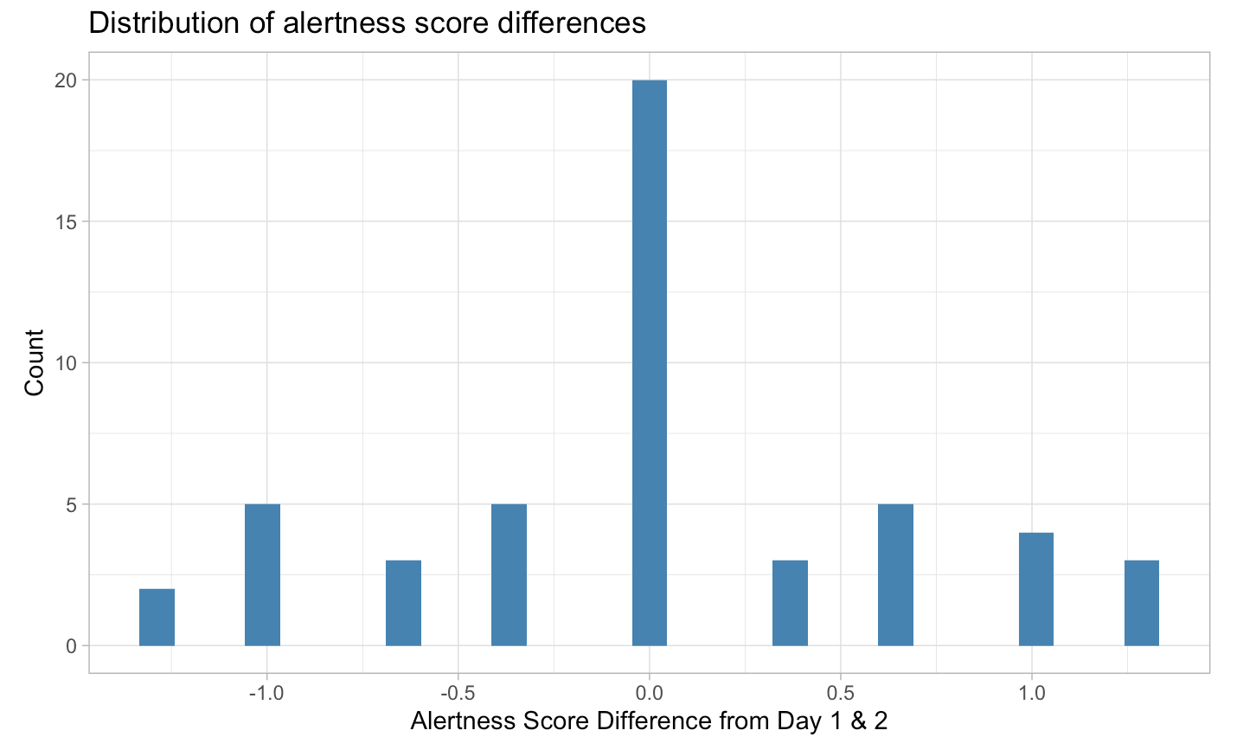
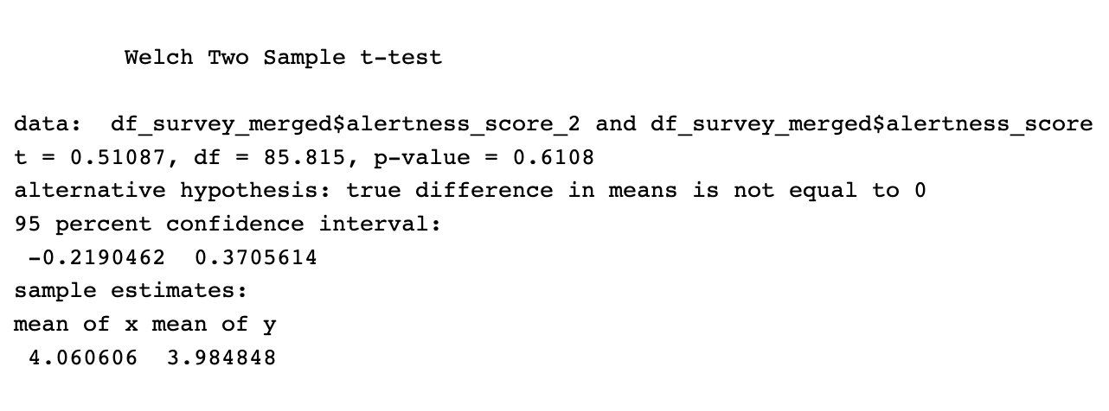
12/14
Project Analysis and Results - Third Party Panel
“Third Party Panel” participants are defined as study participants that were enrolled from a paid panel provider, Prolific
115 total respondents, but 44 who properly complied and met the screening criteria
Selection criteria: individuals must drink a least 4 cups of coffee/week
Compliance with the timing of drinking coffee at 20 minutes and 2 hours of waking up was an issue
Calculated a composite alertness score for the dependent variable (average of three metrics), and took the difference between day 2 and day 1.
We ran a Welch Two Sample t-test against day 1 and day 2 alertness score, and it came back not statistically significant, with a p-value of 0.6
The histogram of differences shows a symmetrical distribution centered at 0
Controlling for coffee amount shows stat sig at 4+ cups, however only 1 participant met that so results are not usable

Slide 14


13/14
Conclusion
This experiment was designed to determine if delaying coffee after waking up vs drinking it closer to waking up would lead to more alertness and increased energy levels
Operationalized this concept by defining control and treatment groups
Created survey to assess participants 6 hours after waking up
A total of 44 participants were in our in-network experiment
Cleaned the data and applied some “fuzzy” time windows to account for some non-compliant data
The calculated treatment effects for between subjects and paired differences were not statistically significant and did not find statistically significant predictor variables in the regression analysis. This was true across both respondent pools.
Overall this is an interesting result but there is some hesitation on fully accepting this result due to low sample size
Increasing the sample size could lead a more precise answer with confidence

Slide 15


14/14
THANK YOU!

